Slide 1
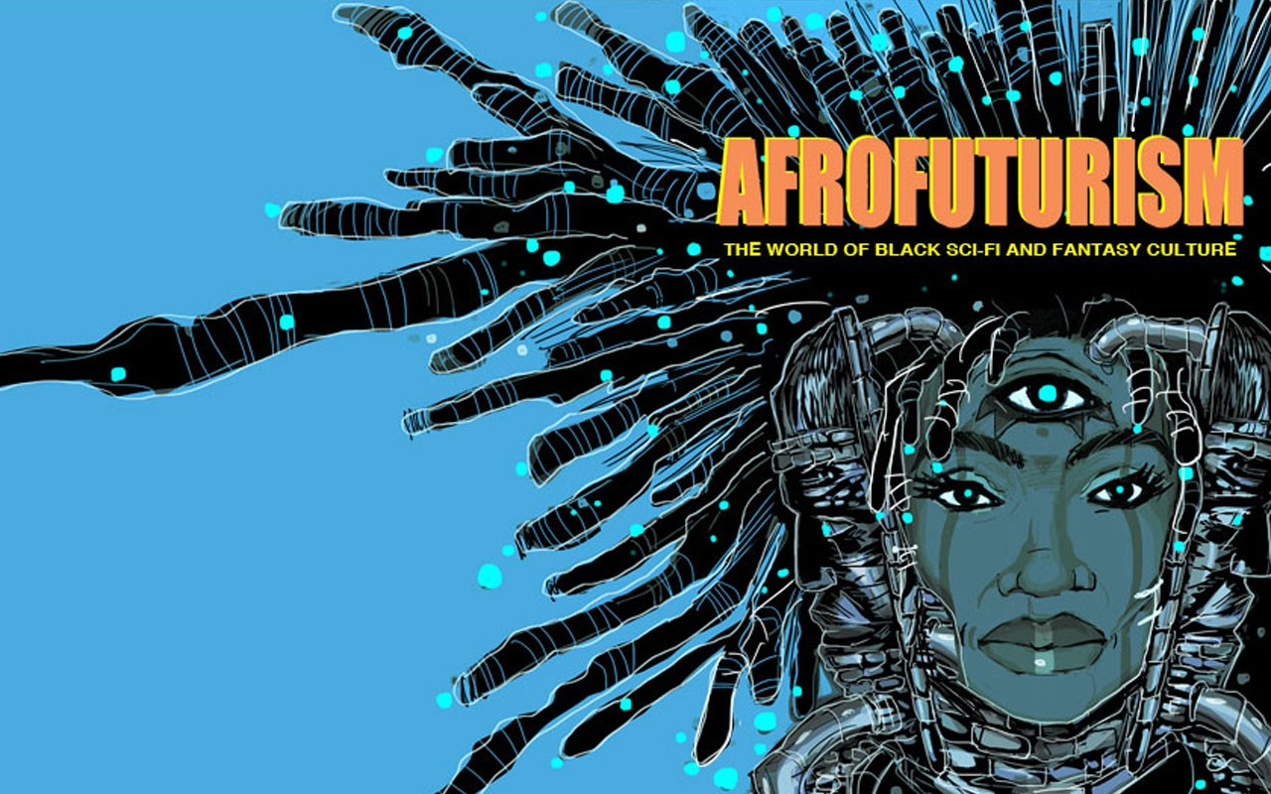
Representation
Celebration
Appropriation
Exploitation
Transcendence

Slide 2
A movement in literature, music, art, etc., featuring futuristic or science fiction themes which incorporate elements of black history and culture.
Afrofuturism
/ˌafrəʊˈfjuːtʃərɪz(ə)m/
(noun)
Afrofuturism is the reimagining of a future filled with arts, science and technology seen through a black lens.
The term was conceived a quarter-century ago by white author Mark Dery in his essay “Black to the Future,” which looks at speculative fiction within the African diaspora.
Jamie Broadnax, ”What the Heck is Afrofuturism” (Huffington Post, 2018)

Slide 3
Diaspora
1 - the scattering of the Jews to countries outside of Palestine after the Babylonian captivity.
2 - any group migration or flight from a country or region.
3 - any group that has been dispersed outside its traditional homeland, especially involuntarily, as Africans during the trans-Atlantic slave trade.
- Dictionary.com

Slide 4
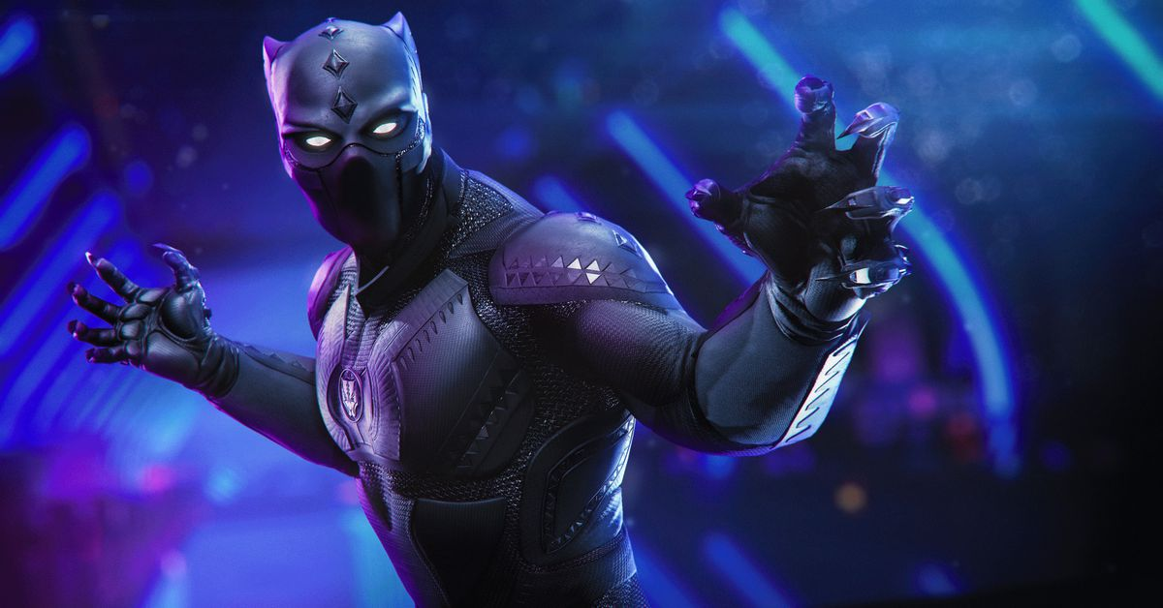
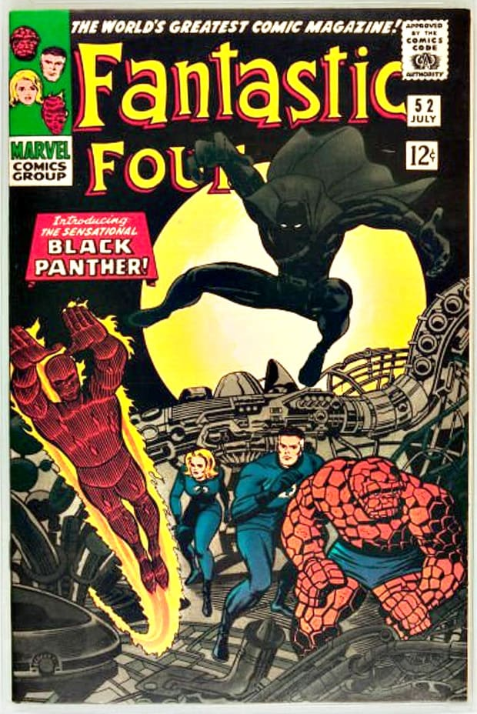
BLACK PANTHER
Fictional Character created by Stan Lee and Jack Kirby from Marvel Comics.
The first black superhero made his debut in a 1966 edition of The Fantastic Four.
Interestingly the character made his debut in the same year activists Bobby Seale
and Huey P. Newton founded the Black Panther Party

Slide 5
Cultural Appropriation
Cultural appropriation is the unacknowledged or inappropriate adoption of an element or elements of one culture or identity by members of another culture or identity. This can be controversial when members of a dominant culture appropriate from minority cultures.
- Wikipedia

Slide 6
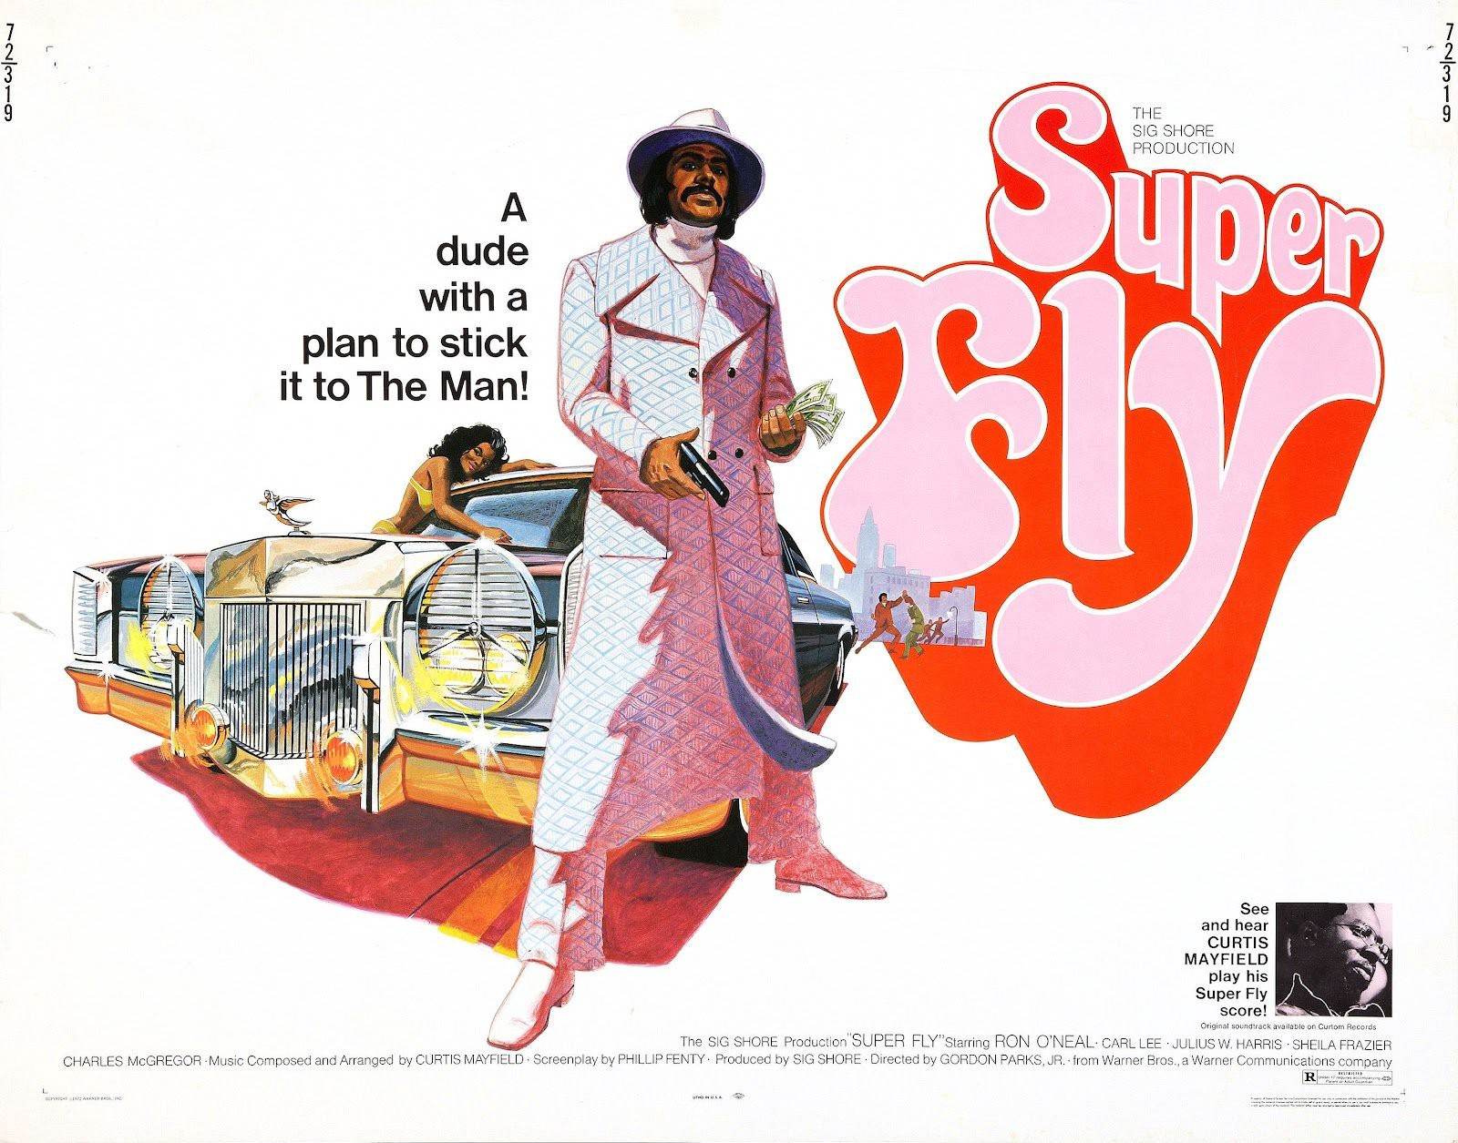
Blaxploitation
Black subgenre of 1970s exploitation films (Low budget B-movies designed to capitalize on current trends and issues)
Often criticized for furthering black stereotypes of
violent criminals, addicts, pimps, whores and pushers
The genre ranks among the first in which black characters and communities are the heroes and subjects of film and television - rather than sidekicks, villains, or victims of brutality.
Shaft Trailer (1971)

Slide 7
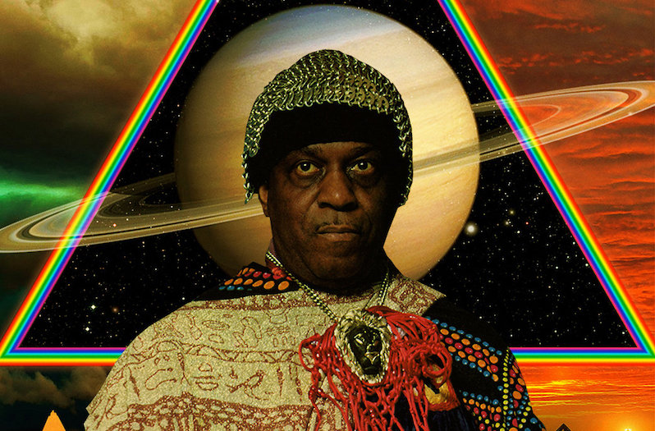
SUN RA: The Black Myth 23:20-26:50

Slide 8
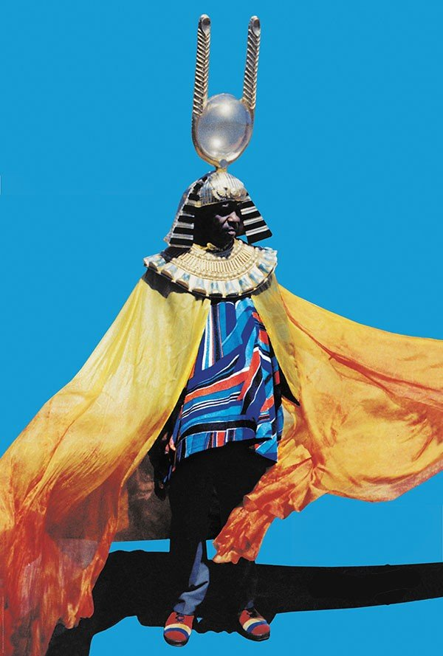
SPACE IS THE PLACE
The idea of space travel felt new for a little earthbound Black child like myself. The idea that there was a space right above my head, whose tonality mirrored my skin color — a sea of Blackness — where I could chase things more divine than what is on Earth — the planet rings, the stardust, and the all-encompassing darkness that would provide the backdrop to my cosmic adventure.
MYLES E JOHNSON | SUN RA ALTERED THE DESTINY FOR A GENERATION OF ARTISTS
(AFROPUNK (2019))

Slide 9
The Third Space
Third Space Theory suggests that every person is a hybrid of their unique set of affinities (identity factors).
Conditions and locations of social and cultural exclusion have their reflection in symbolic conditions and locations of cultural exchange.
- Wikipedia

Slide 10
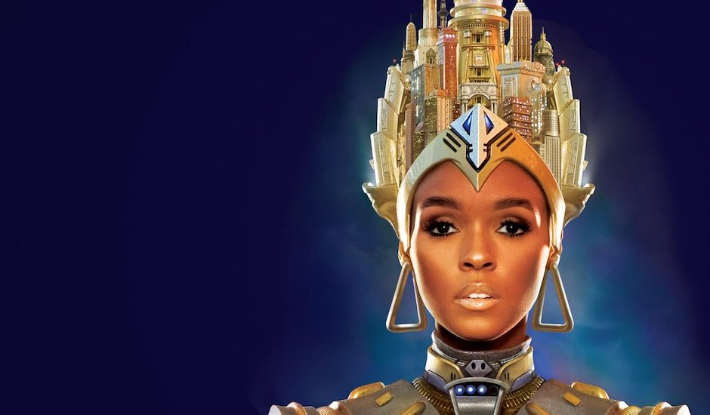
LOVING THE ALIEN
Janelle Monae: The Metropolis Suite / Archandroid
Personas / Alter-Egos: Cindi Mayweather / Jane
Cindy is an android and I love speaking about the android because they are the new "other". People are afraid of the other and I believe we're going to live in a world with androids because of technology and the way it advances. The first album she was running because she had fallen in love with a human and she was being disassembled for that.
Hybridity / race / gender / sexuality / fluidity

Slide 11
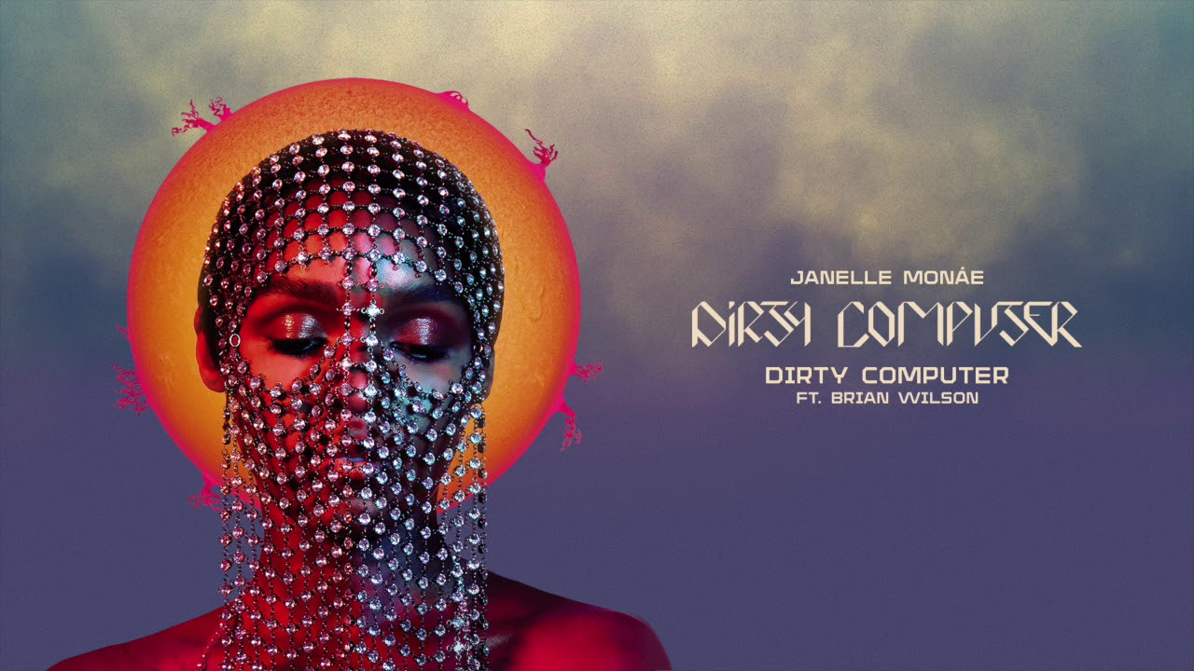
< Jane 57821 // Dirty Computer
And even when you edit me the booty don't lie (what?) Yeah, I'ma keep singing, I'ma keep writing songs I'm tired of Marvin asking me, "What's Going On? March to the streets 'cause I'm willing and I'm able (what?) Categorize me, I defy every label And while you're selling dope, we're gonna keep selling hope (uh)
Janelle Monae, “Q.U.E.E.N” The Electric Lady (2013)

Slide 12
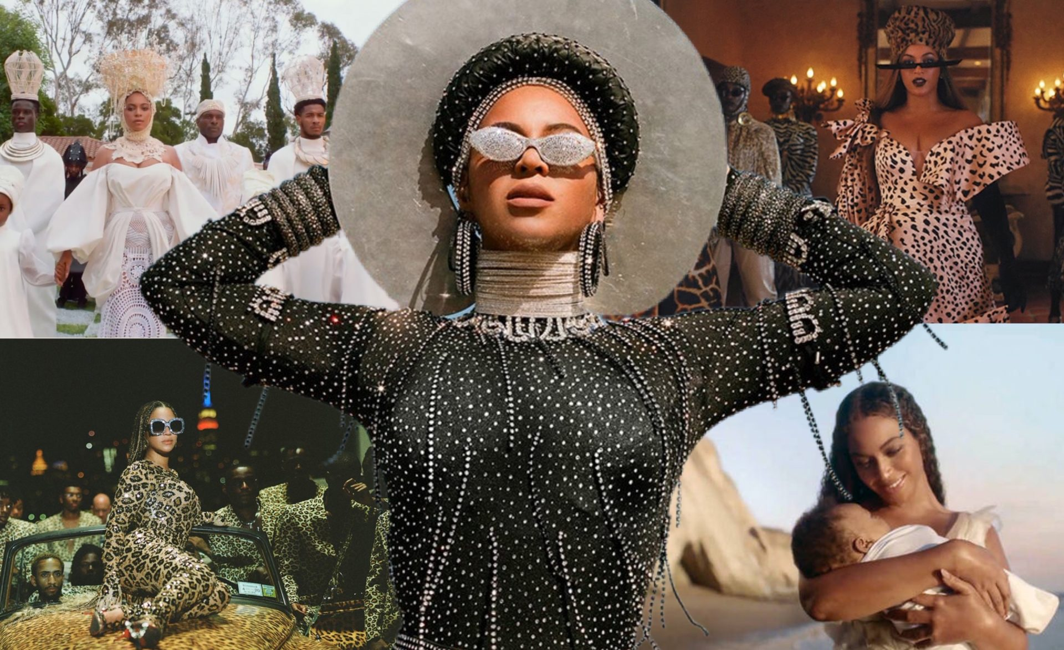
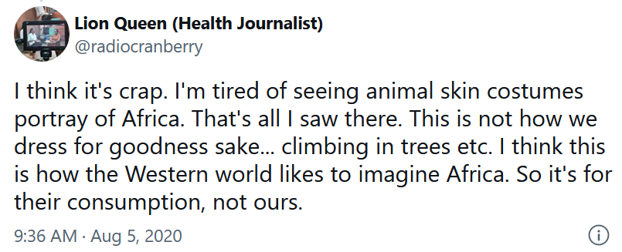
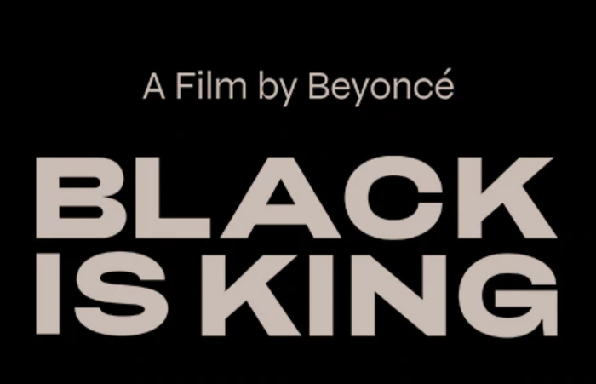
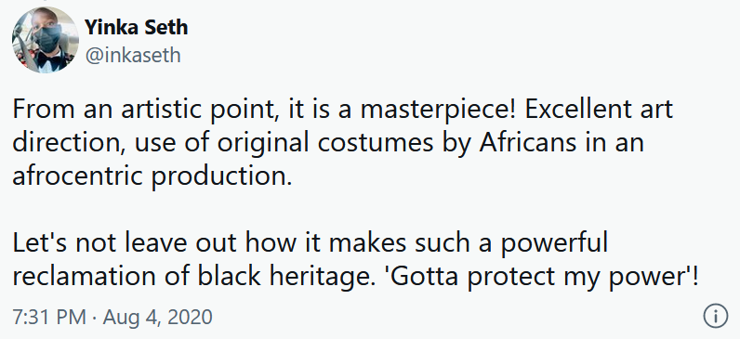

Slide 13
Now Let’s Watch Black Panther

