Slide 1
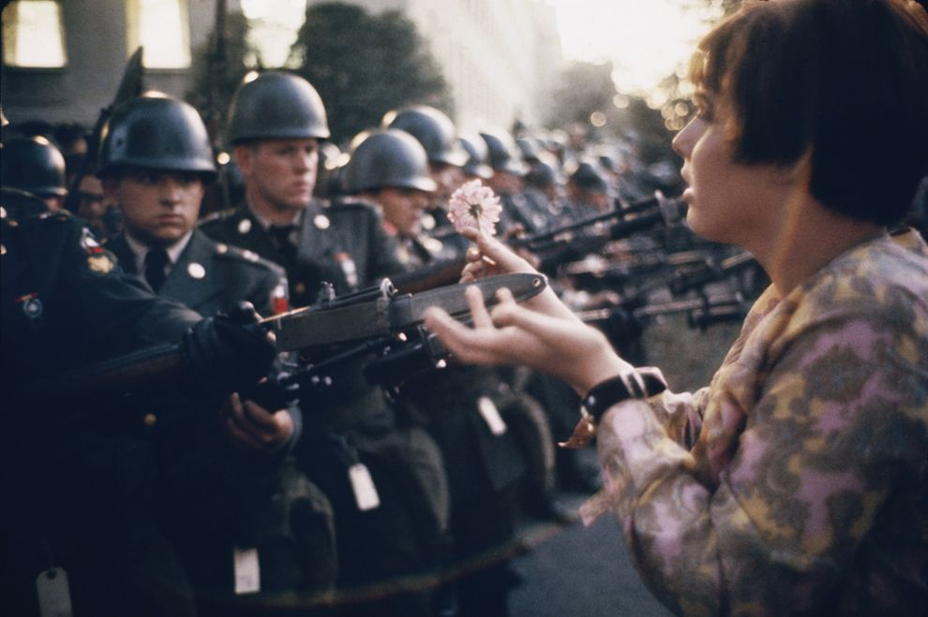
America in the 1960s
Soul, Beauty and Empowerment

Slide 2
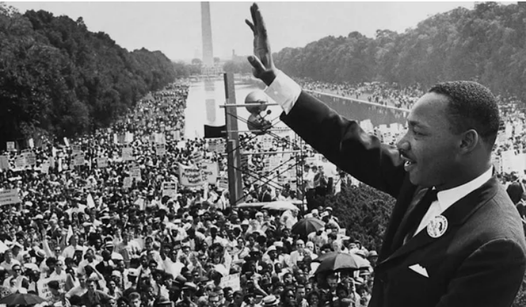
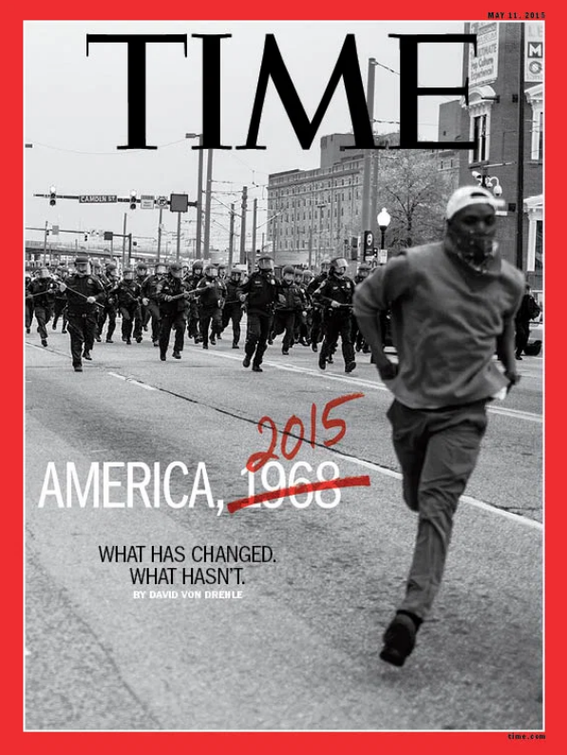
Martin Luther King
Nonviolence and Integration through Soul Force

Slide 3
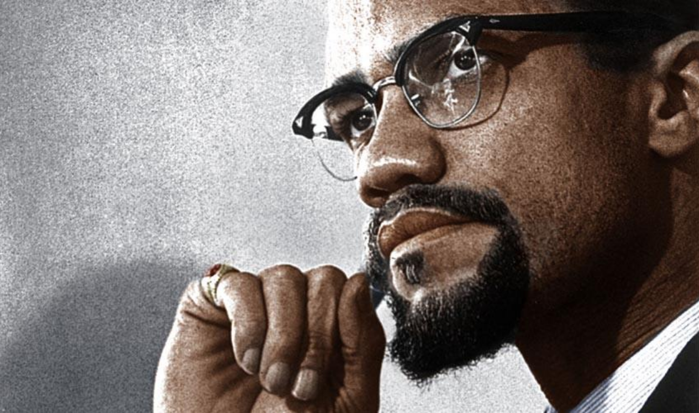
Malcolm X and the Nation of Islam
Seperatism and Equal Rights by Any Means Necessary
The Ballot and the Bullet

Slide 4
“Prevent the RISE OF A “MESSIAH” who could unify, and electrify, the militant black nationalist movement. Malcolm X might have been such a “messiah;” he is the martyr of the movement today. Martin Luther King, Stokely Carmichael and Elijah Muhammed all aspire to this position. Elijah Muhammed is less of a threat because of his age. King could be a very real contender for this position should he abandon his supposed “obedience” to “white, liberal doctrines” (nonviolence) and embrace black nationalism. Carmichael has the necessary charisma to be a real threat in this way.”
Under Director J. Edgar Hoover, the FBI's COINTELPRO (Counterintelligence Program) was aimed at investigating and disrupting dissident political groups within the United States.

Slide 5
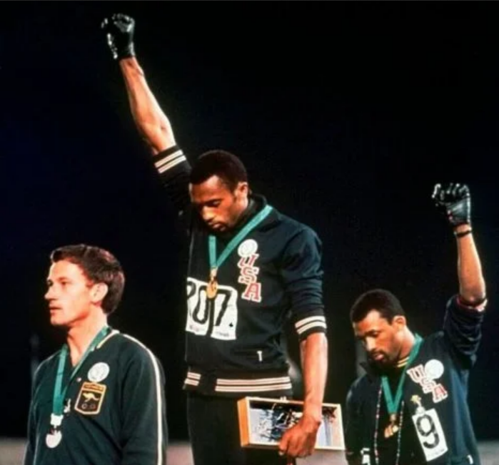
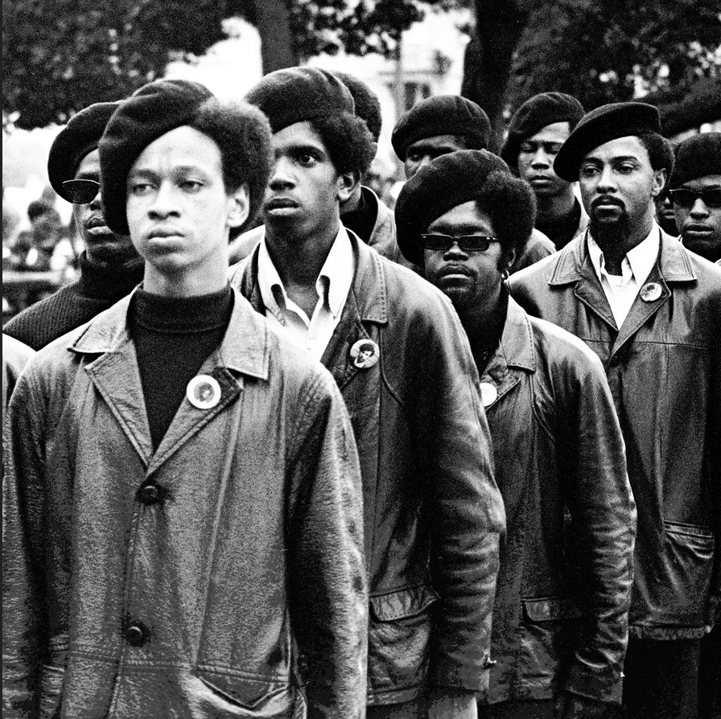
Black Power Salute at the 1968 Olympic Games in Mexico City
Fred Hampton’s Bed after his Nighttime Assassination by Police in 1969
Members of the Black Panther Party

Slide 6
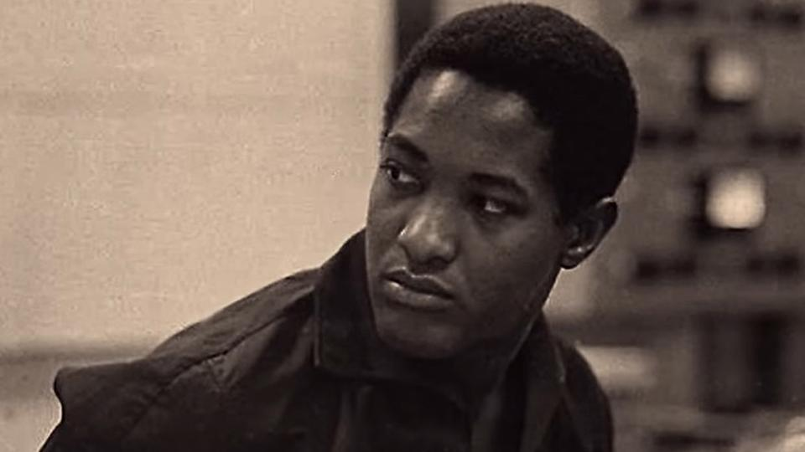
Sam Cooke’s pioneering contributions to soul music contributed to the rise of Aretha Franklin, Bobby Womack, Al Green, Curtis Mayfield, Stevie Wonder and Marvin Gaye and popularized the work of Otis Redding and James Brown

Slide 7
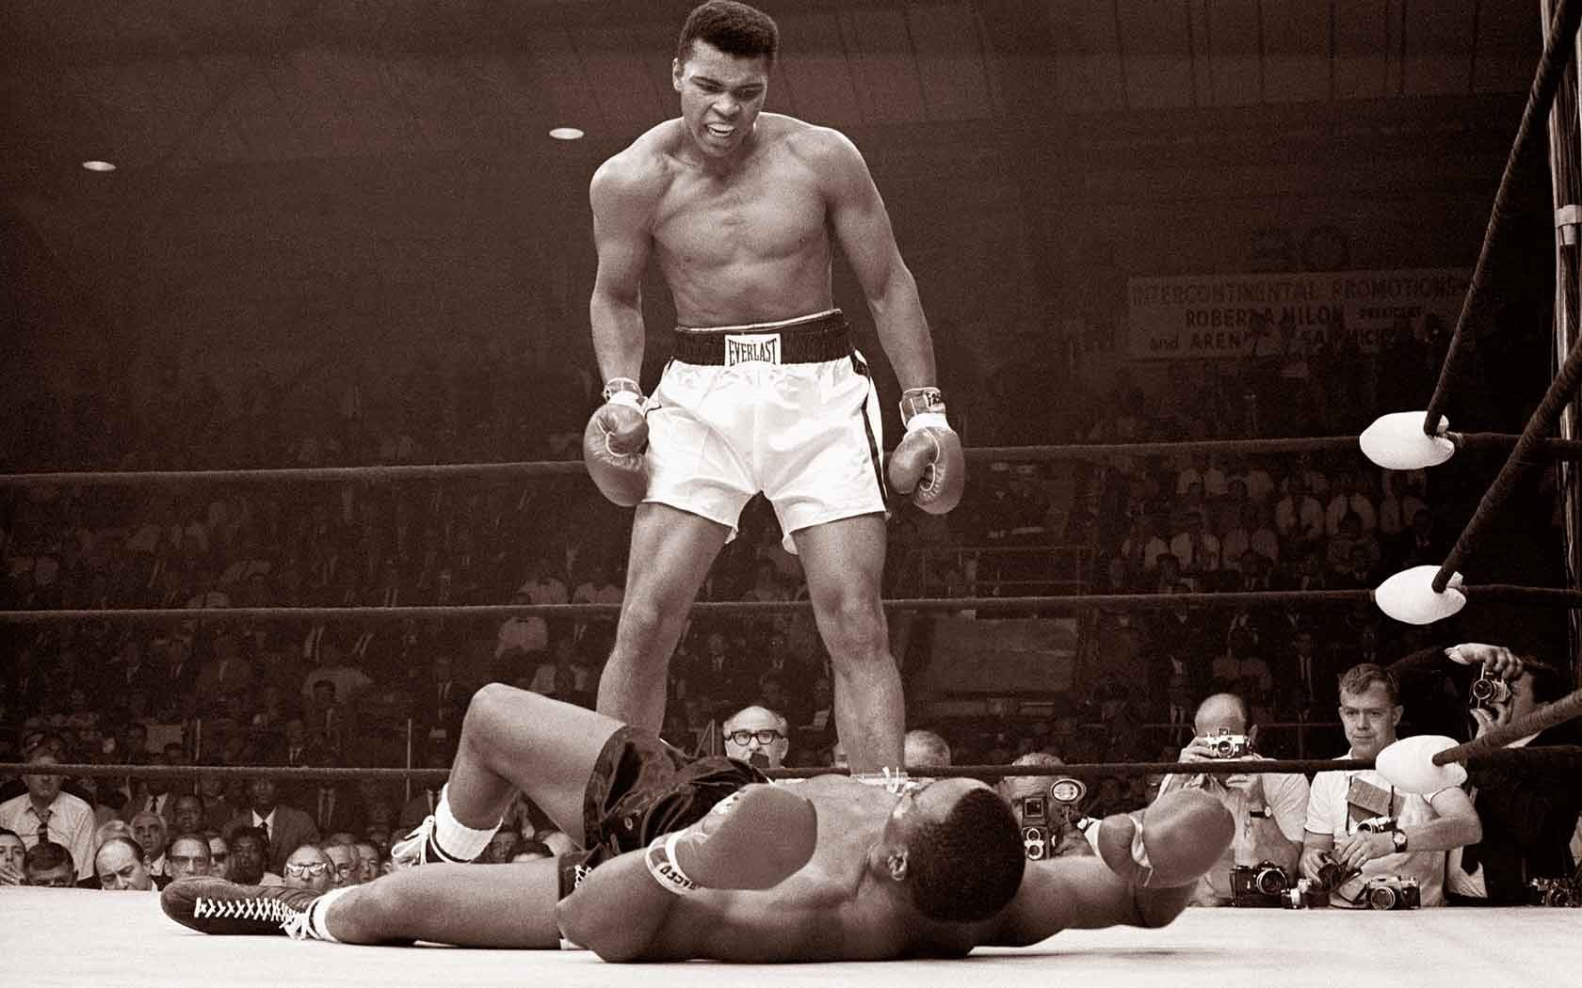
Cassius Clay
Muhammad Ali

Slide 8
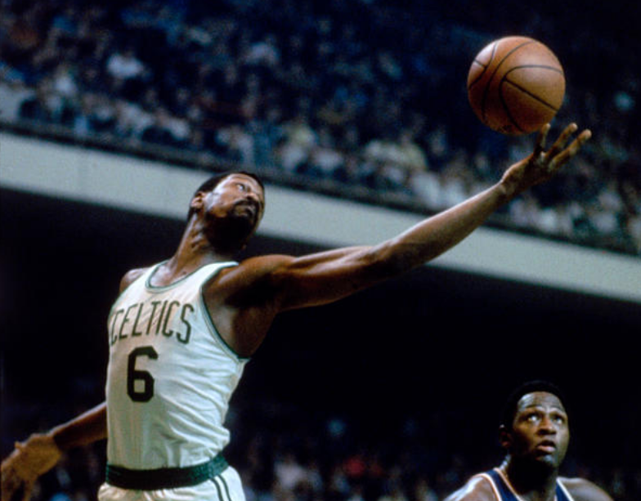
NBA Star and Civil Rights Activist Bill Russell

Slide 10
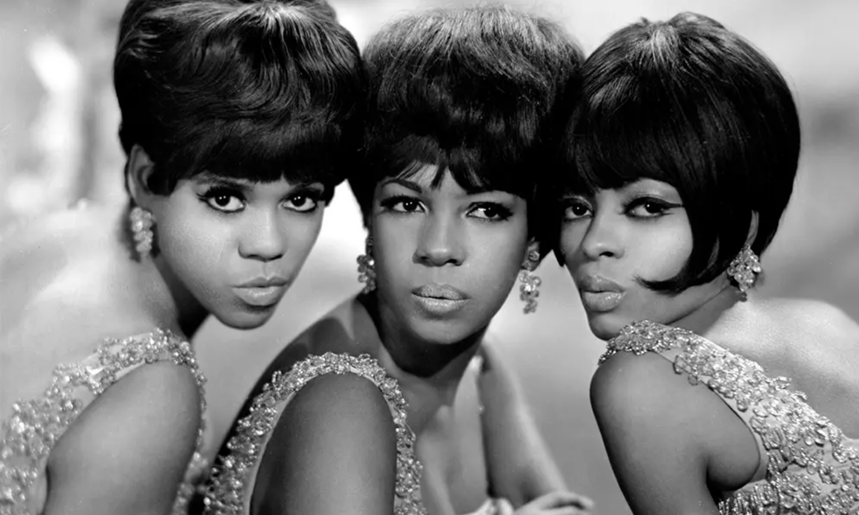
Black Beauty | The Supremes

Slide 11
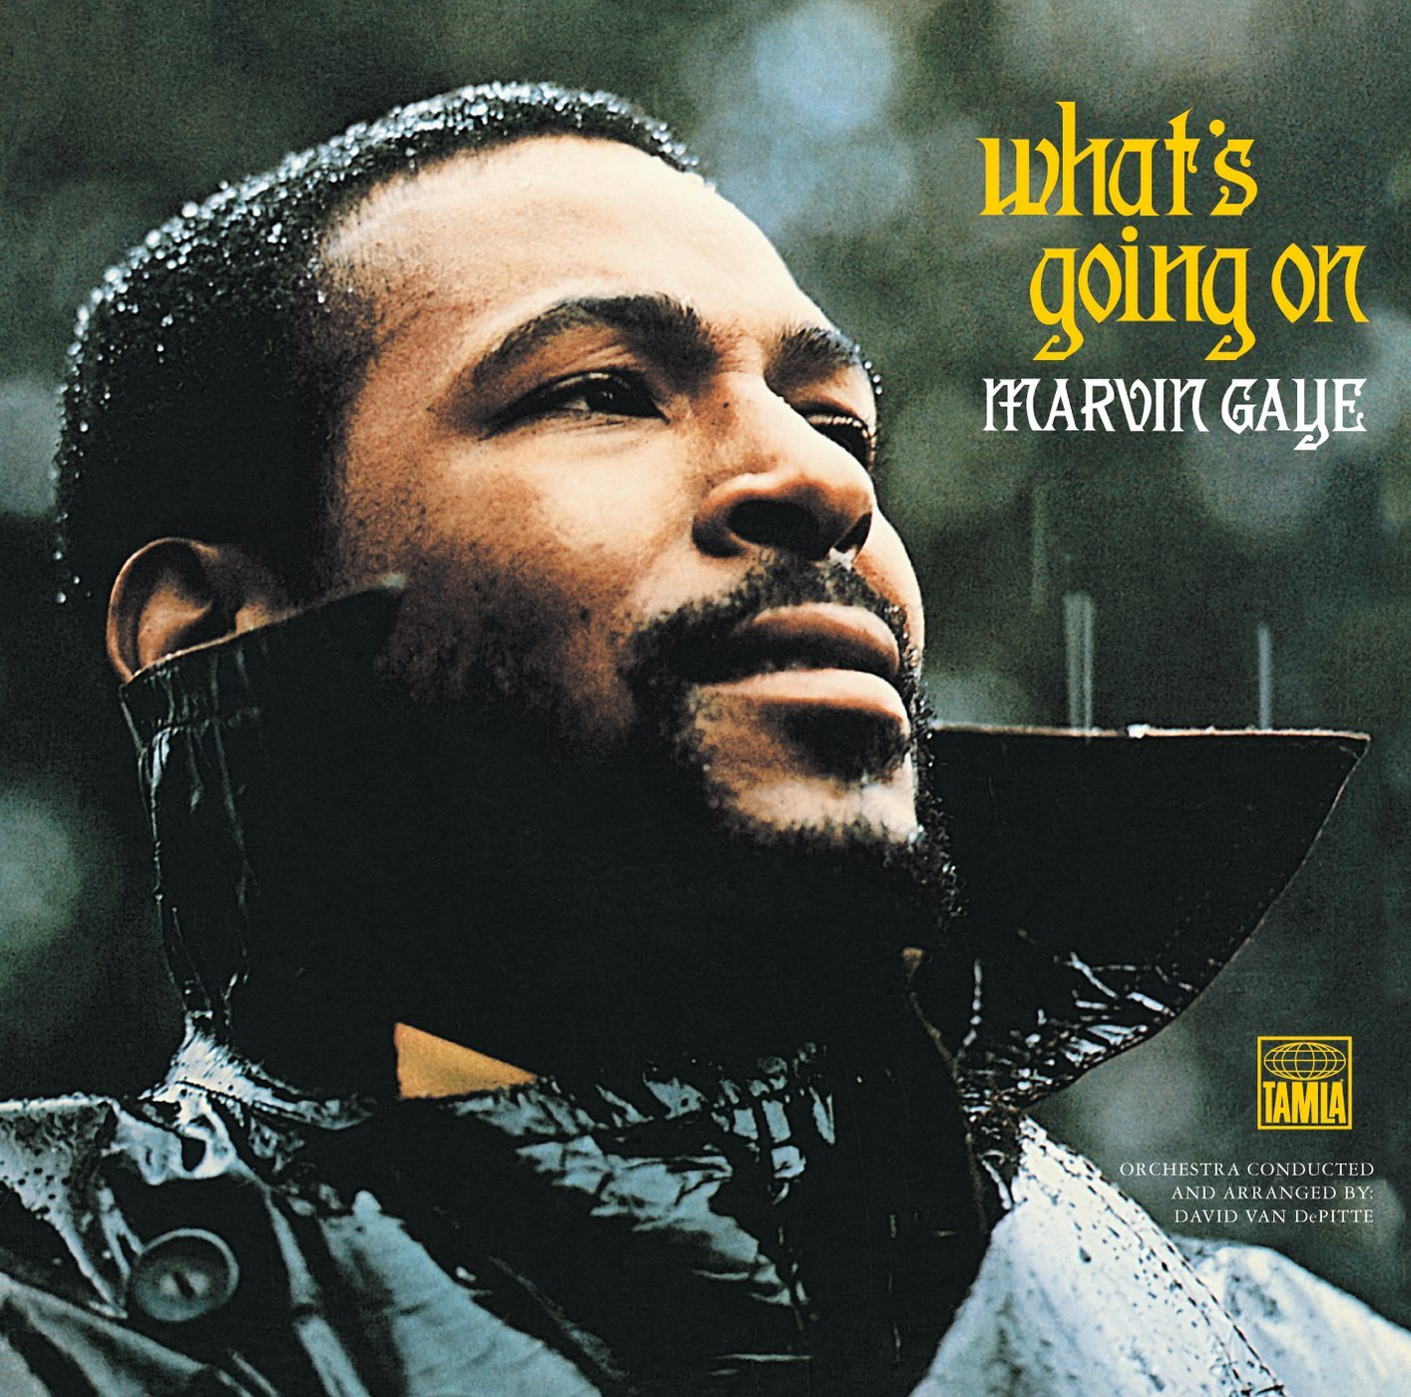
Marvin Gaye’s political concept album ”What’s going on” was released to commercial and critical succes in 1971

Slide 12
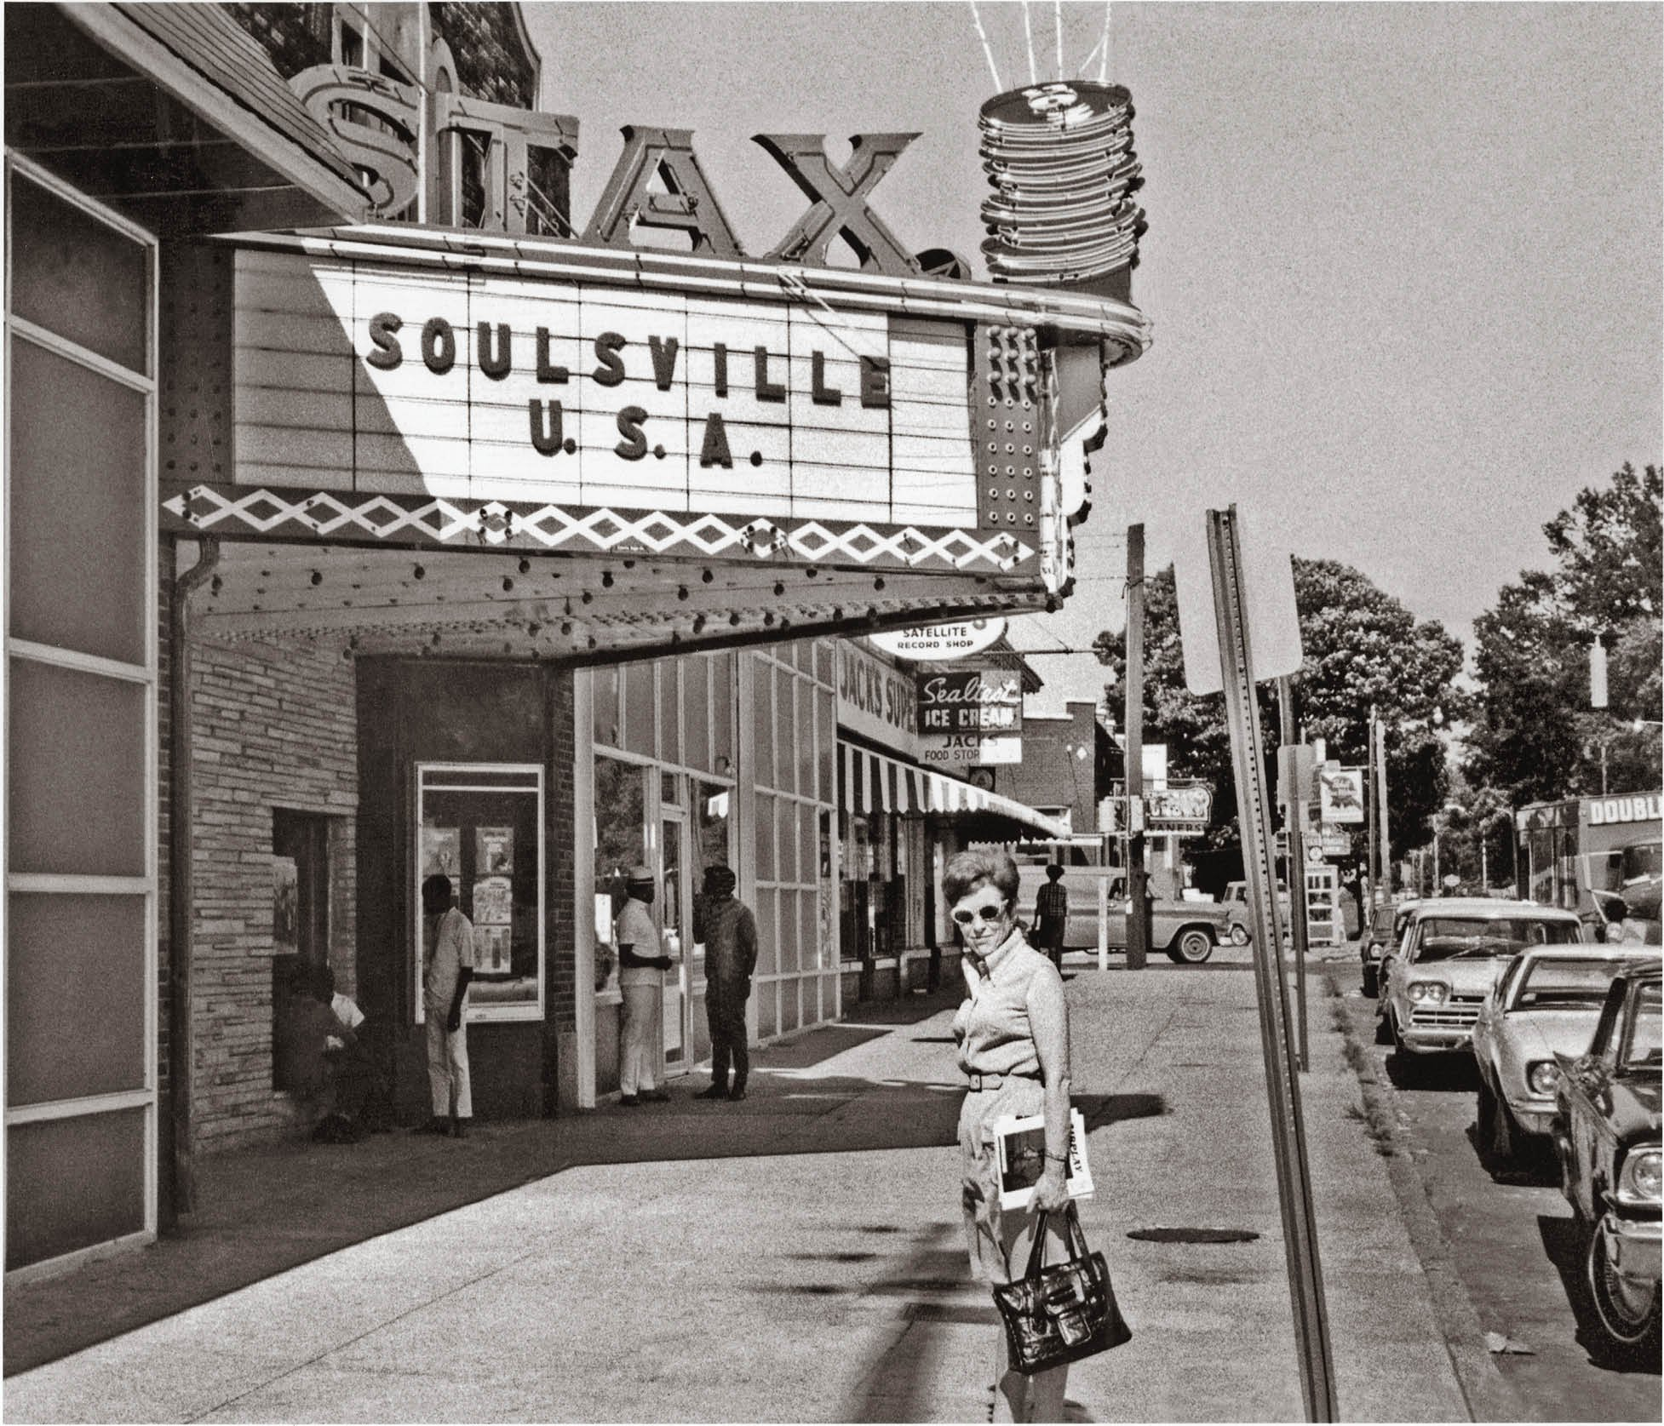

Slide 13
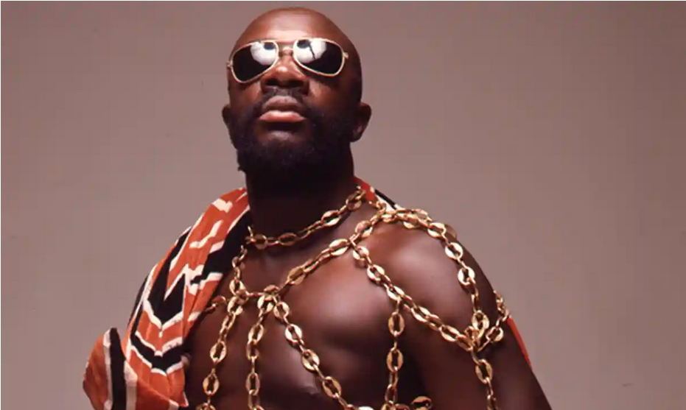
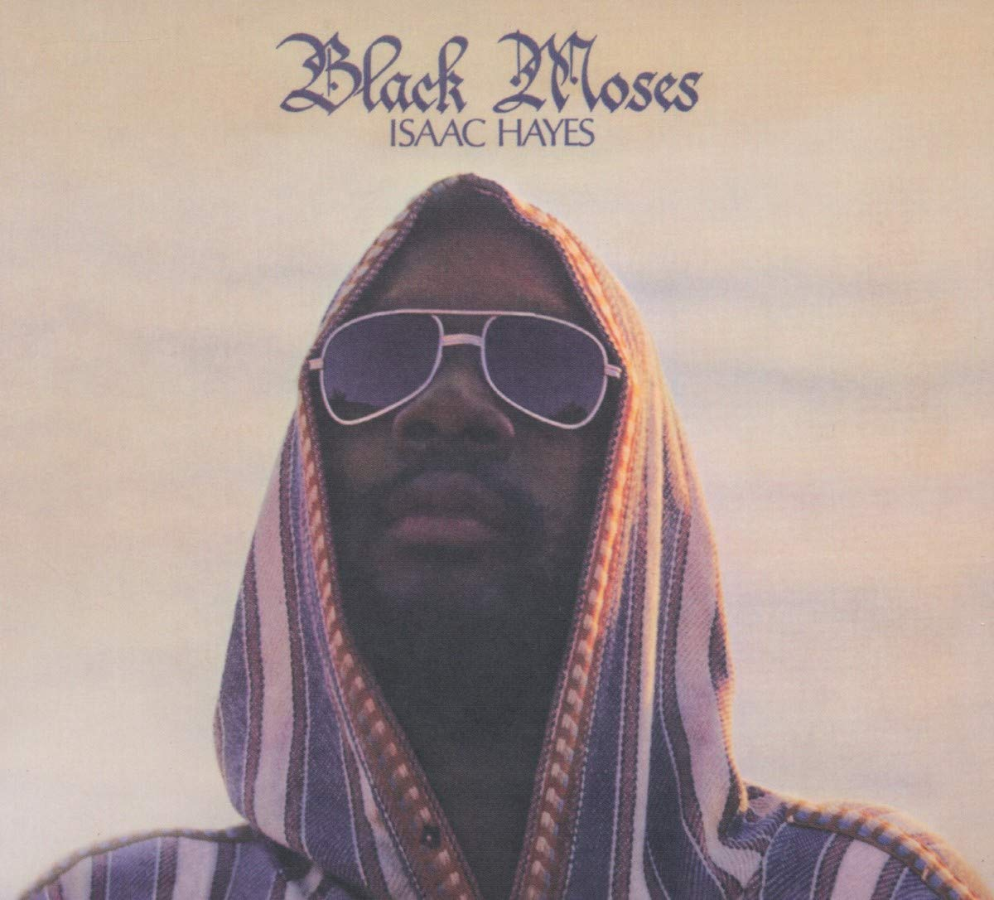
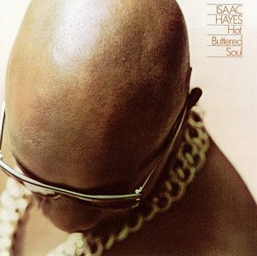
“Chains once represented slavery to a black man in this country. I said, I'm going to turn it around -- these chains are a symbol of strength and power.
So I kept wearing them."
- Isaac Hayes

Slide 14
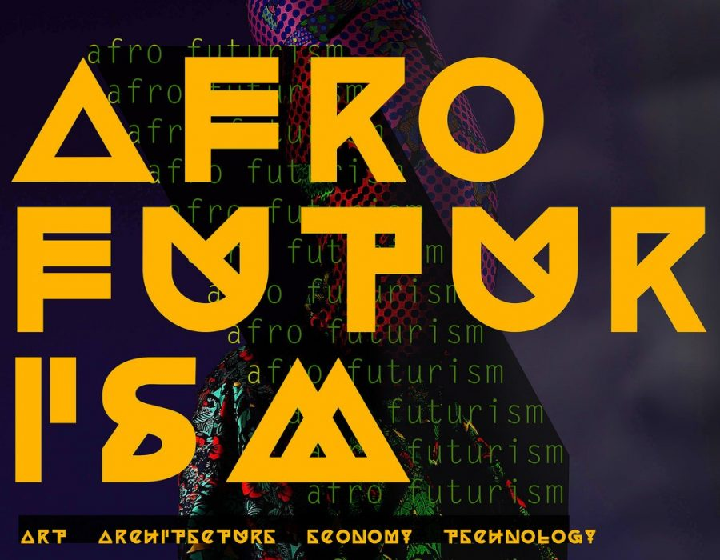
Afrofuturism is a cultural aesthetic, philosophy of science and philosophy of history that explores the developing intersection of African diaspora culture with technology

Slide 15
