Slide 1

Talk about
Virtual Boardgame

Slide 2
How to Play
Join your group in the breakout room in Teams
Choose one player as administrator.
Admin:
  Open the powerpoint containing Let’s Talk About – Virtual Boardgame
  Share your screen so all players can see the board
  Place the playing pieces on Start
All players choose a coloured playing piece.
Roll a die and move your piece the required number of squares.
Talk about the subject shown on the square.
VIRTUAL DICE ROLLER
https://www.random.org/dice/?num=1

Slide 3
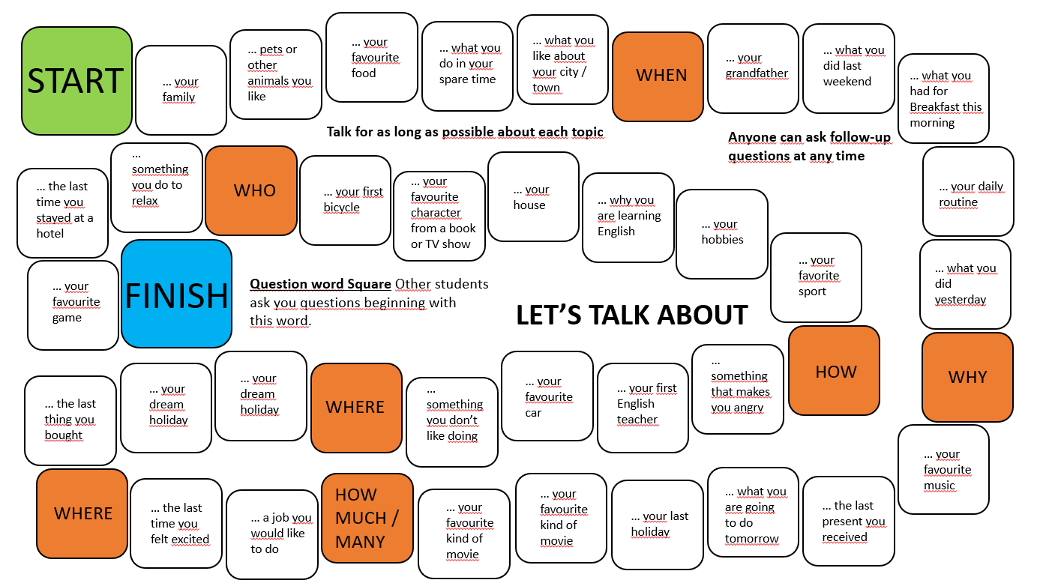
Playing Pieces

